Slide 1



RUBIBOT
END-TERM REPORT

Slide 2
INTRODUCTION
RubiBot is a collaborative project offered by SpeedCubing Club and Robotics Club. This Robot would be capable of solving the 3*3*3 Rubik's cube by identifying the scramble and analysing the cases of solving the cube.
It would be using advanced methods of speedsolving like the CFOP method aka. Fridrich's Method. The Robot will be traditionally constructed using various devices like sensors, motors, etc.
This project would offer students a chance to have a distinct thinking by having the critical knowledge of speedcubing going hand in hand with Robotics mechanisms.
This project would be involving mechanical as well as technical work, as the backend of the project would be fulfilled by the knowledge of Cubing and its various algorithms while the frontend part would include working on assembling Robot elements and then finally coding so that we get desired outcomes after using algorithms with ease.

Slide 3
TIMELINE OF PROJECT
WEEK 1
WEEK 3
Introduction to Beginner's method and CFOP method
Autodesk Fusion360 assignment
WEEK 2
Worked A online meets and resources were provided
On Autodesk Fusion360

Slide 4
.
WEEK 5
TIMELINE OF PROJECT
.
WEEK 4
WEEK 6
Presentation of bot designs
Discussion and modification of bot design
Selection of bot design
WEEK7
WEEK8
Arduino code and code for scrambling the cube
Hardware integration
WEEKWEEWEE

Slide 5
WEEK 1

Slide 6
BEGINNER'S METHOD AND CFOP METHOD
.
CFOP: This method is an advanced version of the beginner's method and is one of the most widely used method.
In this method CFOP stands for Cross, F2L (First 2 layer), OLL (Orientation of Last Layer), PLL (Permutation of Last layer).
Here we make the base layer cross as same as beginner's method. Then we learn a particular set of algorithms and intuitively use them to solve the First 2 cube layers simultaneously.
In this method also the more algorithms you can memorize the lesser solve times you will get.
Before starting working on the bot itself, we learned the basic terminologies of Rubik's cube like layers, corners, edges and faces. And we also learned how to solve the Rubik's cube using Beginner's method
Link for beginner’s method:
https://ruwix.com/the-rubiks-cube/how-to-solve-the-rubiks-cube-beginners-method/amp/
Link for CFOP method:
http://www.rubiksplace.com/speedcubing/F2L-algorithms

Slide 7
WEEK 2

Slide 8
AUTODESK FUSION360 TUTORIAL
Autodesk Fusion360: We were provided tutorial videos as well as online tutorial by our mentor on basics of Autodesk Fusion 360 software.
We learned about different tools in Fusion 360 and designed a simple hinge by implementing whatever we learnt.
.
Arduino Tutorial: We were provided with a tutorial article and an online live tutorial to teach us about the different aspects of Arduino software side. We learned about the different types of Arduino boards, IDE installation, using computer language to give instructions to the Arduino board and implement different operations.
https://www.arduino.cc/en/software
https://www.youtube.com/watch?v=cGJdwOwvbC8&t=177s
Link for Arduino tutorial:
https://www.tutorialspoint.com/arduino/index.htm

Slide 9
WEEK 3

Slide 10
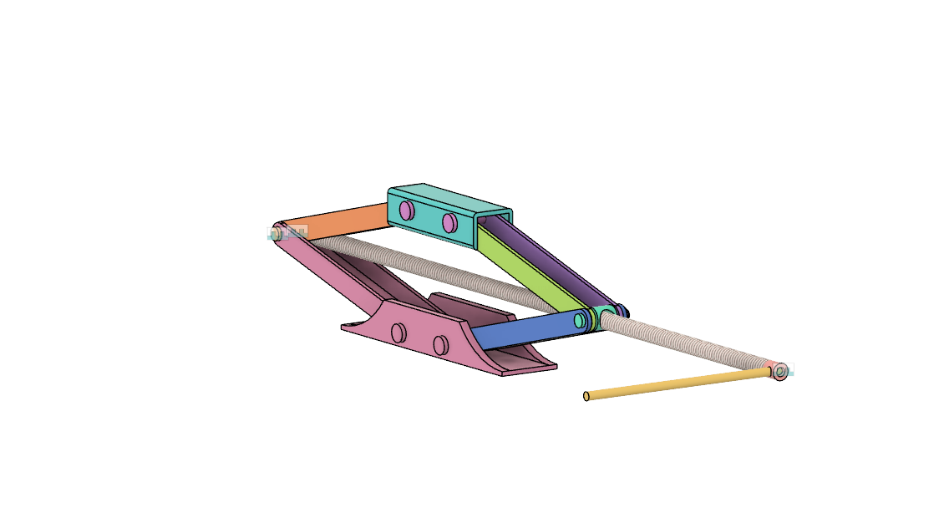
ASSIGNMENT AND INITIAL BOT DESIGN IDEAS
Autodesk Fusion360 Assignment: In week 3 we were given an Autodesk Fusion 360 assignment in which we had to make a model of a screw jack.

Slide 11
WEEK 4
.

Slide 12
PRESENTATION OF BOT DESIGN
In week 4 we were all divided in teams of 5 and we were asked to present ideas for bot design.
We all worked under our respective teams , discussed our individual ideas with each other and completed our bot design.
We had an online meet where each team presented their ideas for the Rubibot, where mentors provided their feedbacks and then asked us to design the respective bots in Fusion360.

Slide 13
WEEK 5
.

Slide 14
DISCUSSION AND MODIFICATION OF BOT DESIGN
we all discussed our respective team work with mentors and they told us about various modification in our designs like our motors should be easily removable , make the design simple and economically affordable
While selecting the Bot design we were asked to take care of the components used, their efficiency and if they are economic to the project. We also tried to improvise our respective ideas, so that we can take out best ideas from different selected design.
After discussion we modified our bot designs.

Slide 15
WEEK 6
.

Slide 16
SELECTION OF BOT DESIGN
After the final completion of bot design in fusion 360 by each teams , mentors selected the best bot design among the teams and we all started working on selected bot design.
During working under teams we come across different ideas and possibilities and after working on this ideas and possibilities we got the most efficient version of our bot.

Slide 17
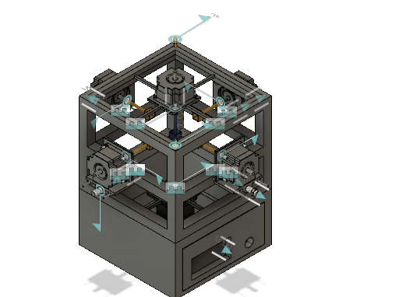
BOT DESIGN

Slide 18
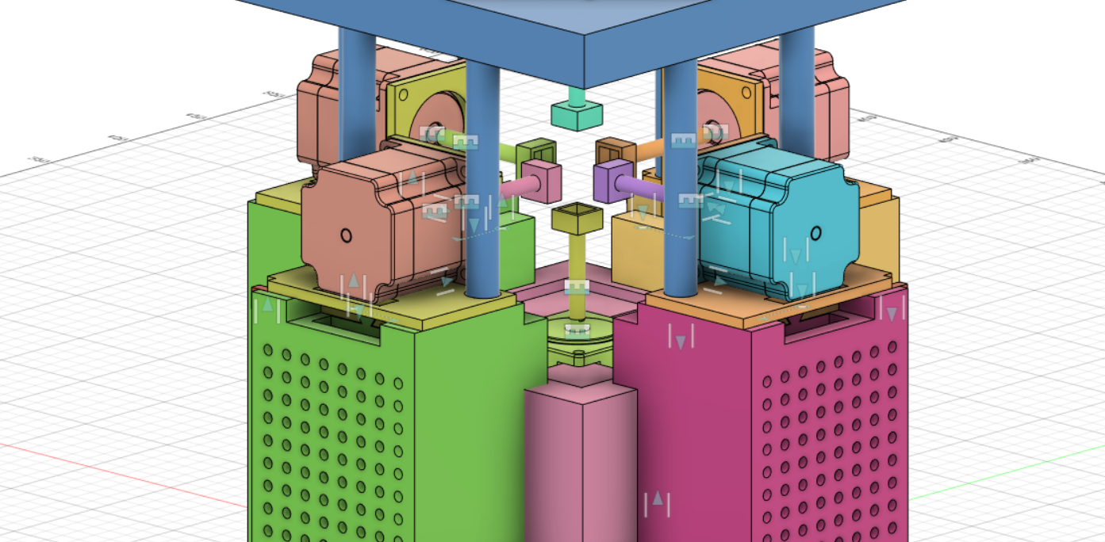
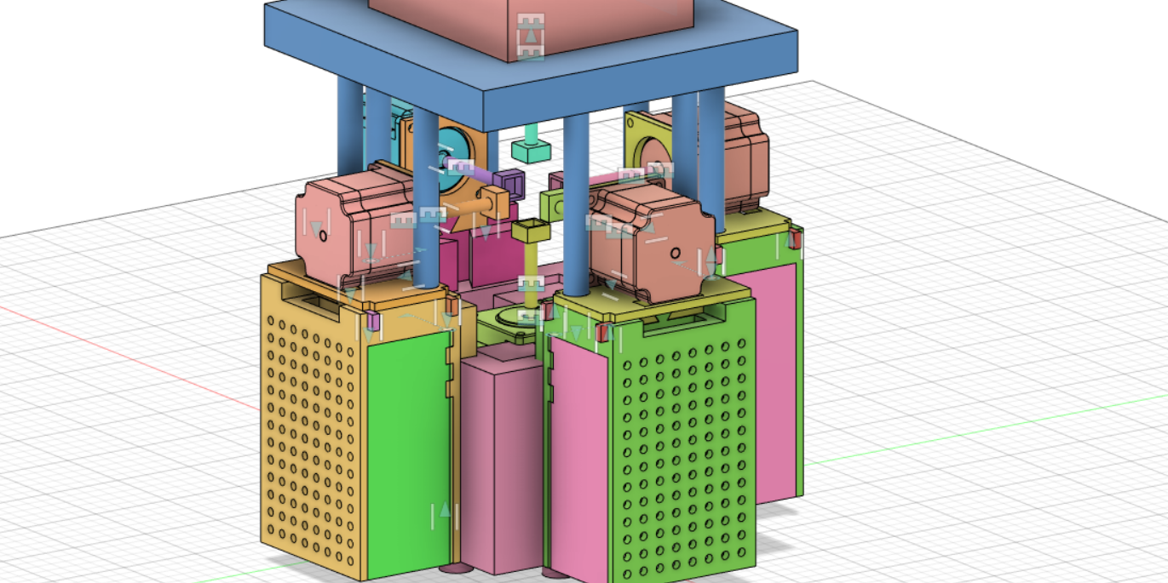
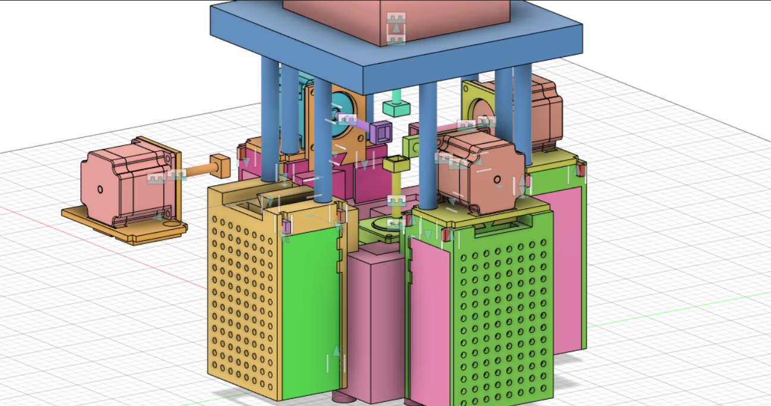

Slide 19
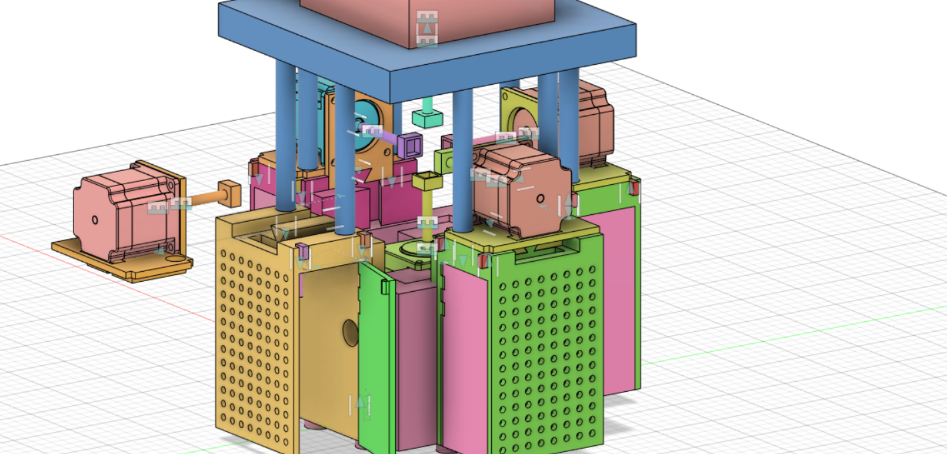
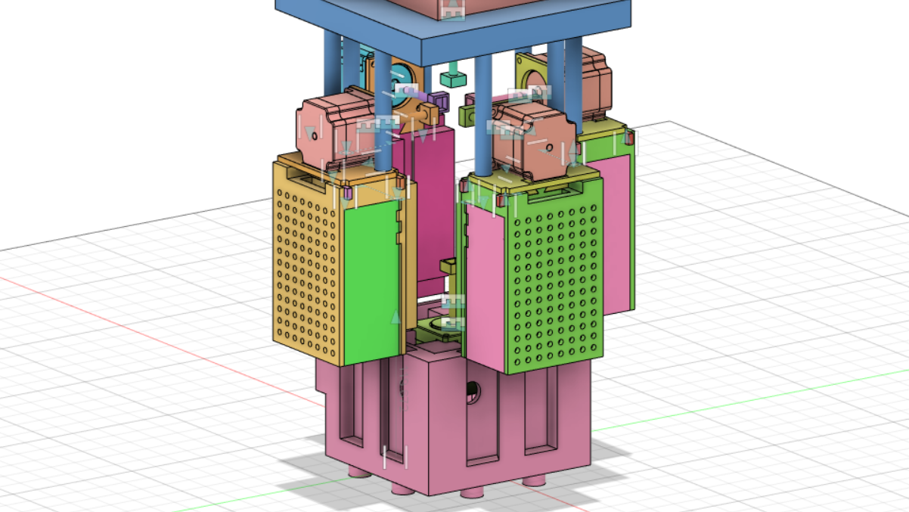

Slide 20
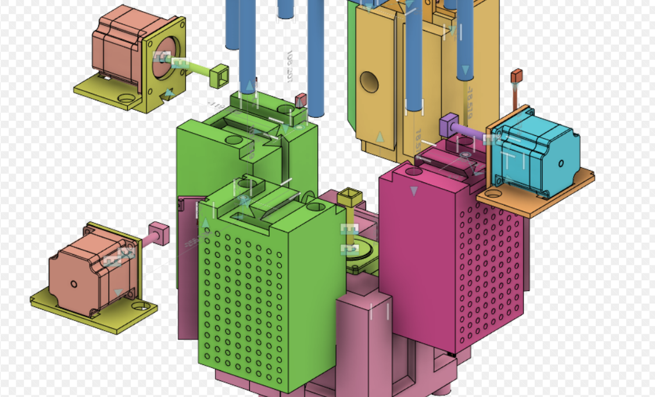
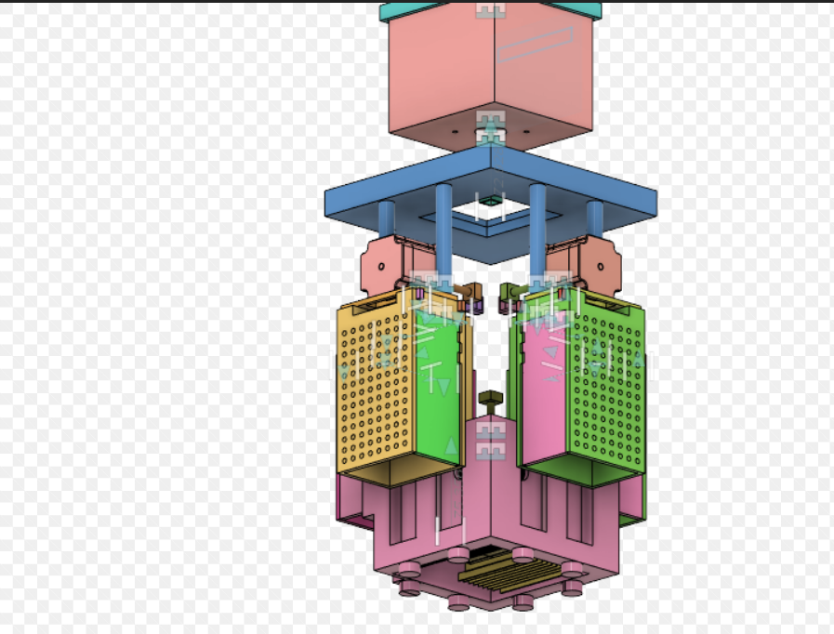

Slide 21
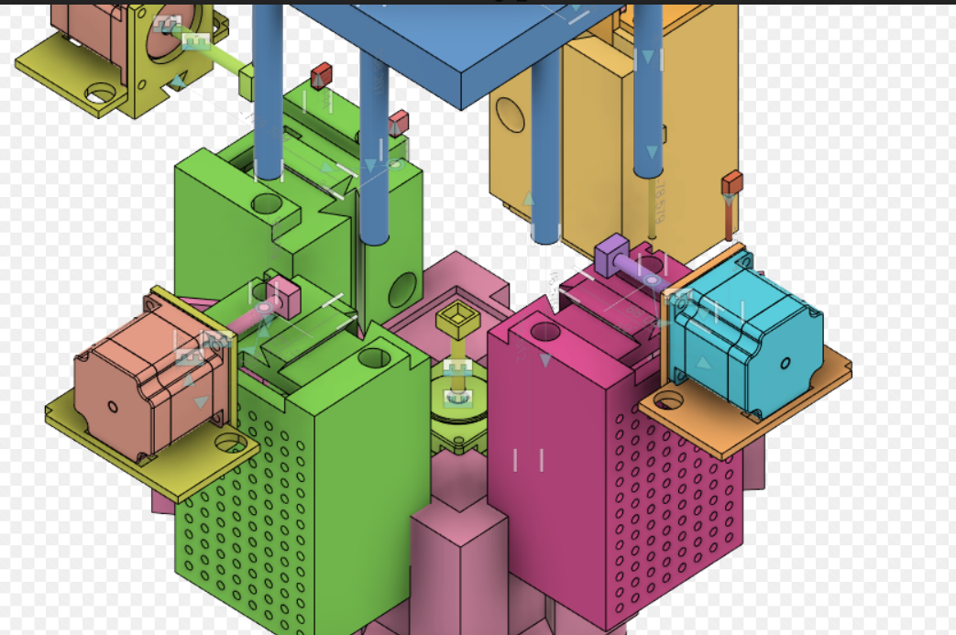

Slide 22
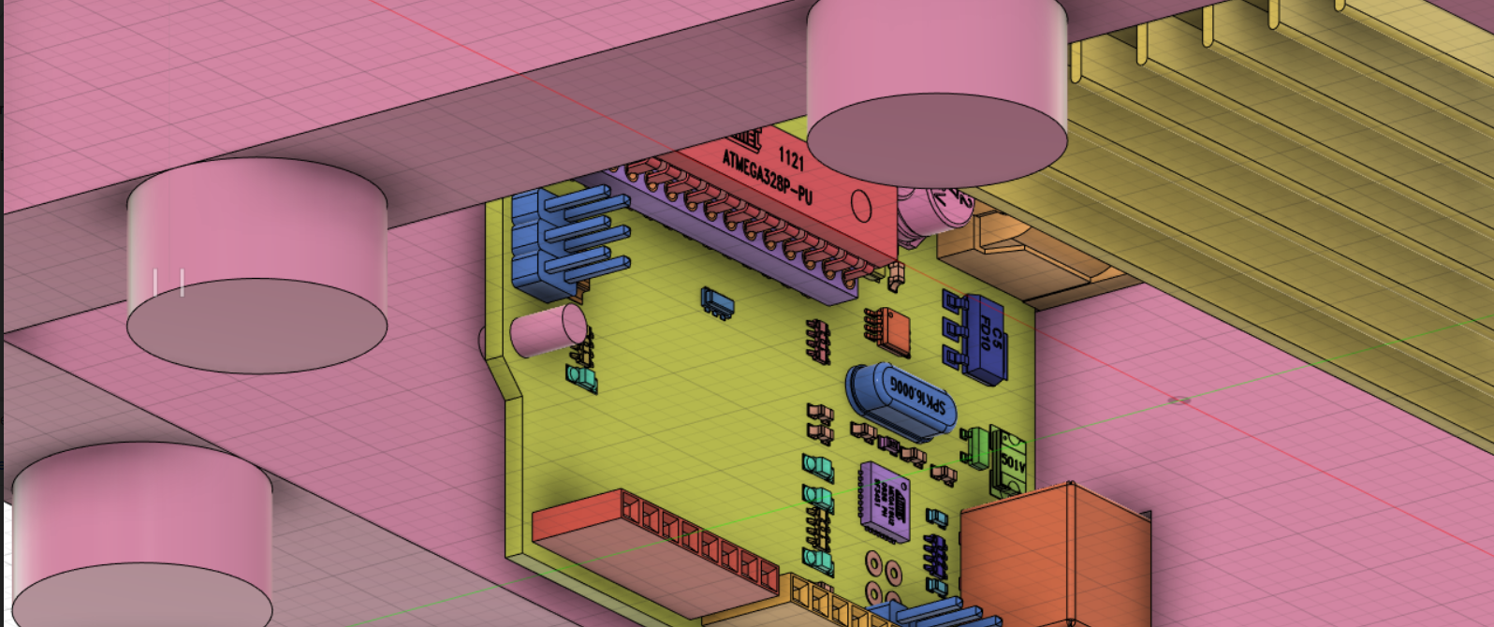
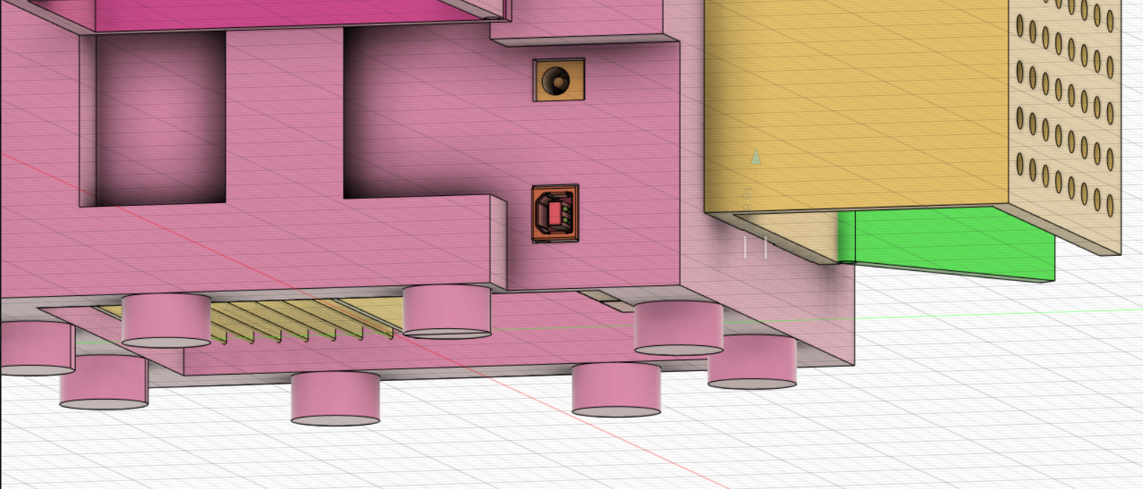

Slide 23
WEEK 7
.

Slide 24
ARDUINO CODE
Given Arduino code takes a string as an input from the Serial Monitor. This string is the solution to the given scramble. The setup function specifies the location of all the output pins to the six motors. The loop function takes one move at a time and performs it on the cube . Here is how the code works:
The solution string is the input to the scramble. Ex: RUruLLfU Here , we use lowercase letters instead of prime symbols, i.e. R represents R’
The code stores the string in a variable using the Serial.readString() function.
The loop () function reads one character at a time and sends it to switch () function.
it also prints the specified move on the terminal.

Slide 25
The switch function tells the code which motors are to be moved and in what direction. For example “R” input will activate the motor connected to right face in the clockwise direction.
The actual motion happens through the rotate () function , which takes motor number , and direction as input and performs a 90 degree turn on the specified motor.
There is a delay of one second (which can be adjusted) before iterating the loop again.

Slide 26
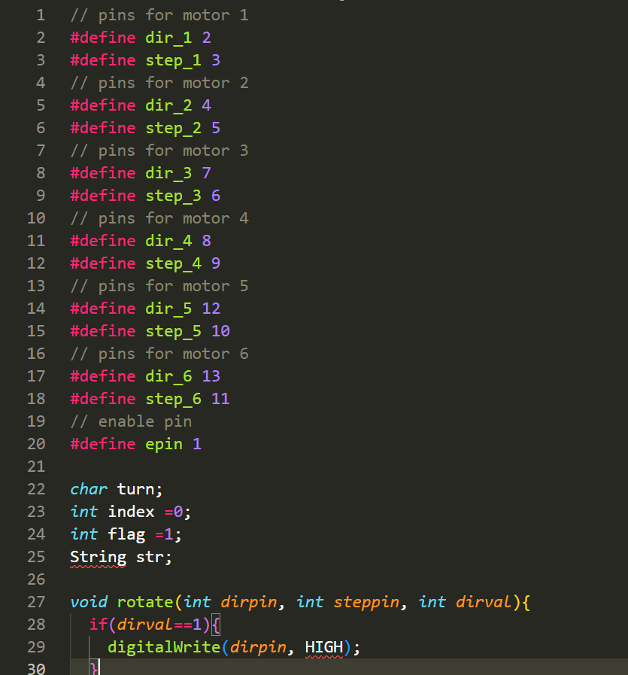
ARDUINO CODE

Slide 27
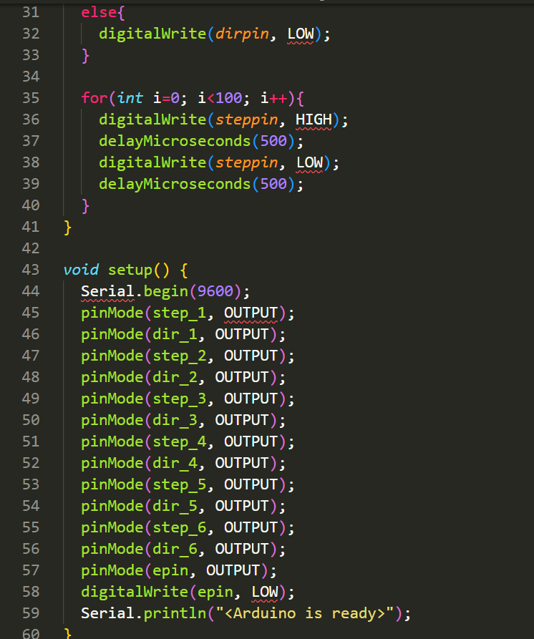
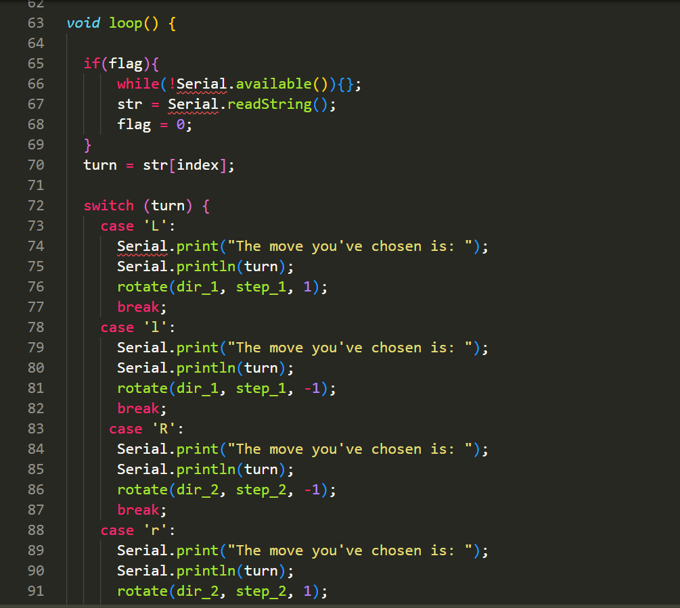

Slide 28
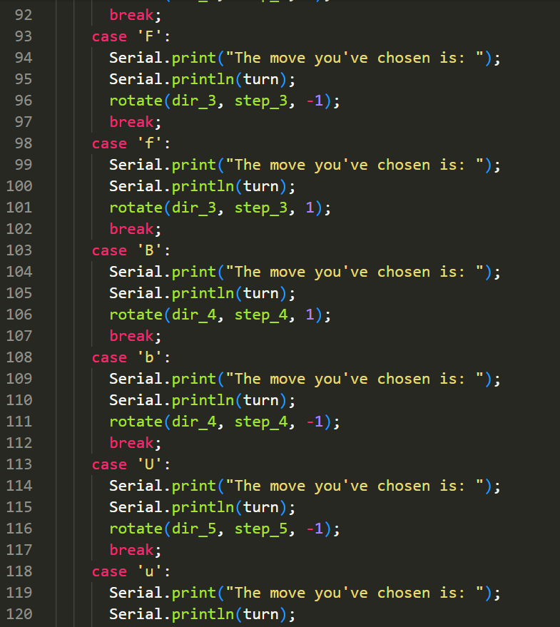
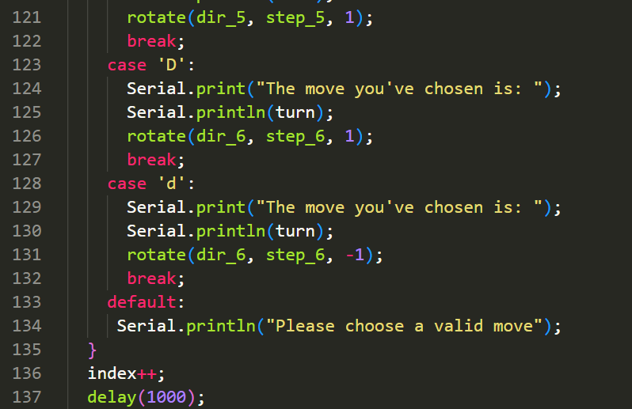

Slide 29
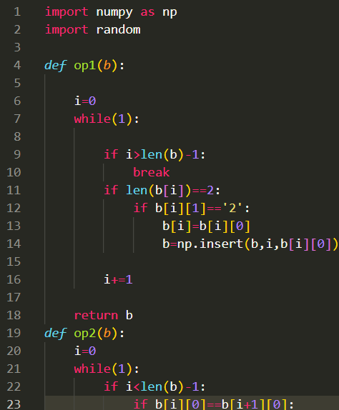
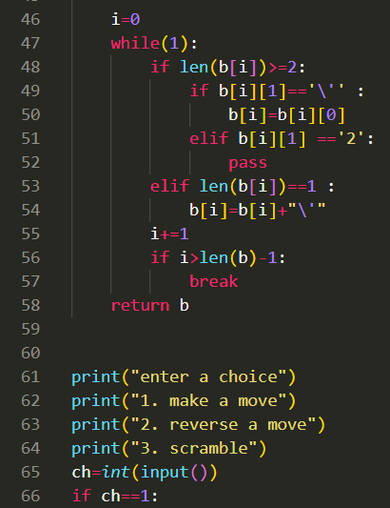
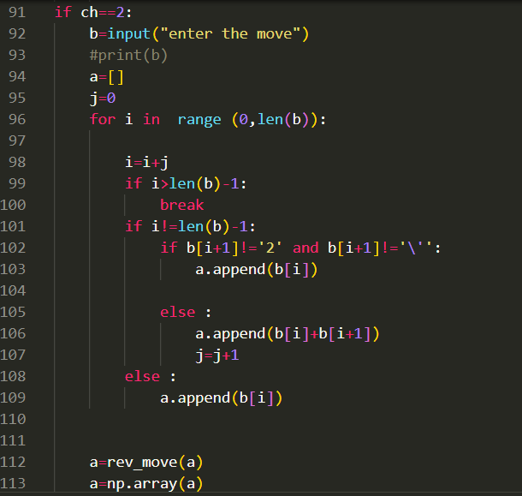
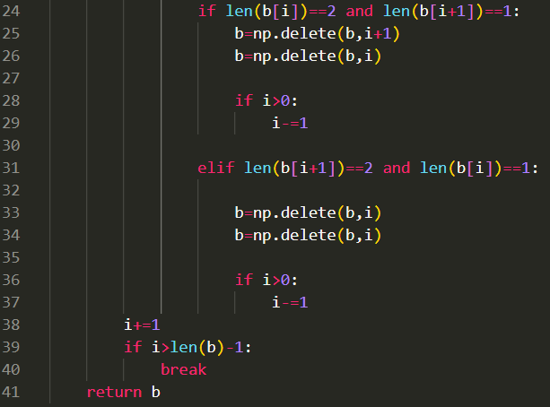
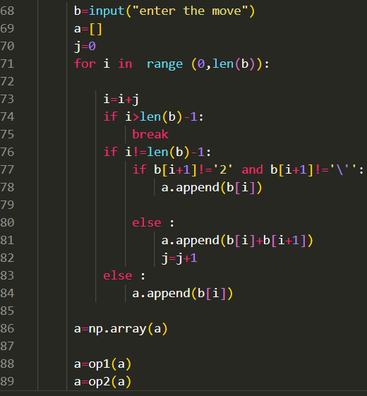
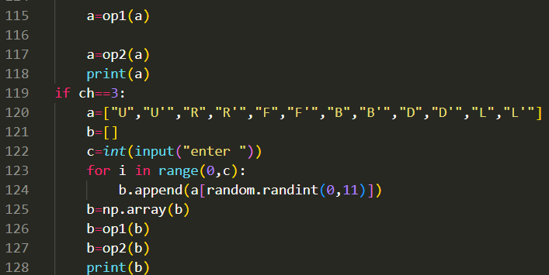
CODE FOR SCRAMBLING THE CUBE
.

Slide 30
.
1) def op1(b) is an optimizer which will convert a given string into an array. We have also converted into a NumPy array.
For example : if input is “R2 U2 F B2 R”
output will be R R U U F B B R
2) def op2(b) is also an optimizer and this will nullify the effect of R and R’.
For example : input : R U U’ R’
it will give a null output
3) def rev_move(a):
b = a[::-1] this will reverse a given array . converts primed into unprimed or unprimed into primed
For example : input : R U F’
output : F U’ R’
We used python because When it is integrated with various libraries, such as Numpy which is a highly optimized library for numerical operations, then the number of weapons increases in your Arsenal i.e whatever operations one can do in Numpy can be combined with OpenCV.
.

Slide 31
WEEK 8
.

Slide 32
HARDWARE INTEGRATION
Approach:
We need one motor to perform moves for each face, thus there would be a total of six motors, all connected to one face each. Thus, a cuboidal frame is ideal.
In order to set the cube inside the bot, we need to offset the motors initially then fix their positions once the cube is set. Thus, the motors need to be able to move slightly from their positions.
There has to be some sort of opening in the bot in order to insert the cube. Thus, we went for a lid that can be opened and closed.
Prototype 1:
Design:
There are six motors corresponding to each face on the cube attached to a cubical frame. Each motor’s axis is attached to a gripper that is designed to fit inside the centre piece of a side of the cube. Four motors on the vertical faces can slide in and out of the frame in order to attach the cube to the centre pieces. The bottom-most motor is fixed in its place and the cube will first attach to this motor only. The top motor is attached to a cross shaped frame that is hinged to the cubical frame. This will allow the box to open so that cube can be placed inside
.

Slide 33



Challenges:
The motors need to be held in place, in order to provide stability during the solve.
The hinged type lid will create problems when the gripper is being inserted into the centre piece of the top face.
There needs to be some compartment for the Arduino and power supply.

Slide 34
Prototype 2:
Major changes include:
Motors will now be attached onto a holder that can slide on rails. These rails are attached to sides of the bot frame. Once the cube has been placed in the bot, the holders can be closed in and screwed at place. This way we can fix the cube more accurately.
The top-most motor is now attached to a separate flat frame that acts as a lid onto the bot. once the cube is loaded, the lid is placed along with the motor, and small cork that holds the lid in place.
There is a separate compartment at the bottom of the structure which holds all electrical control systems like Arduino, power supply, etc.
Challenges:
The final design is completely different from initial prototypes but is based on the same principals. Because the 3d printer can only print a small volume, the entire design needs to be made modular.
The driver gets heated up during use, thus there needs to be proper ventilation for the driver’s heat to escape.
Since the body is modular i.e., made of different small parts, they need to be held together firmly so that there is no stability issue during the solve.

Slide 35
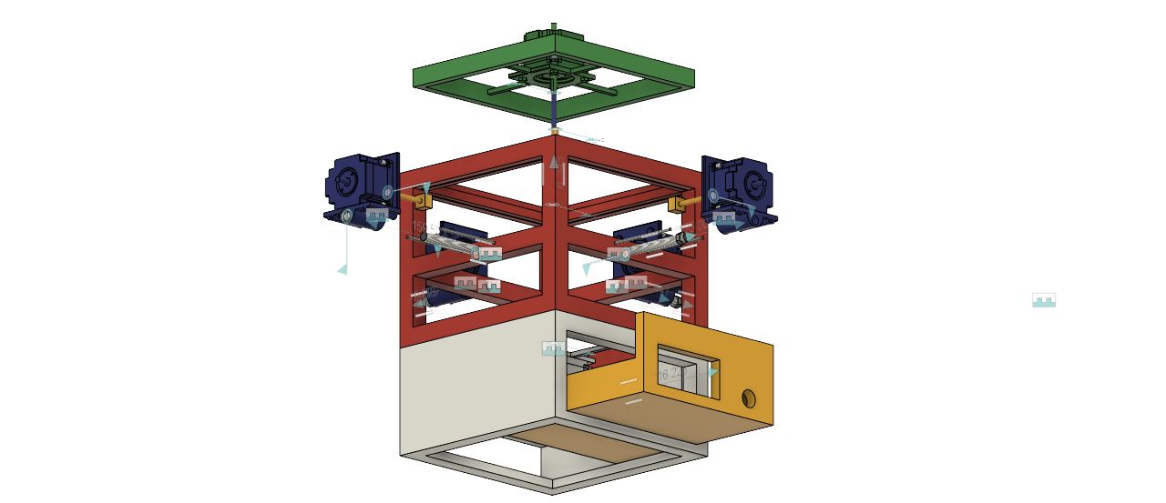
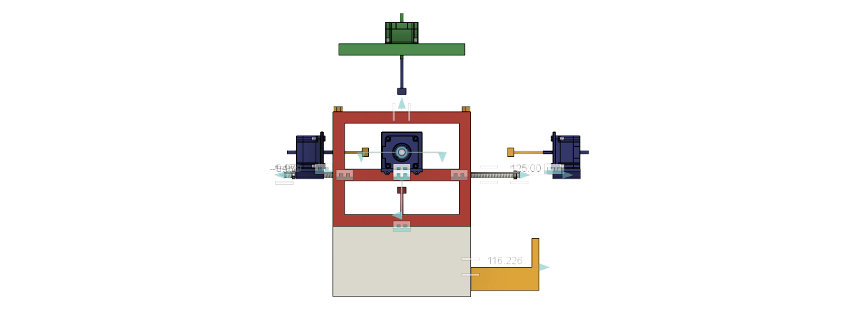
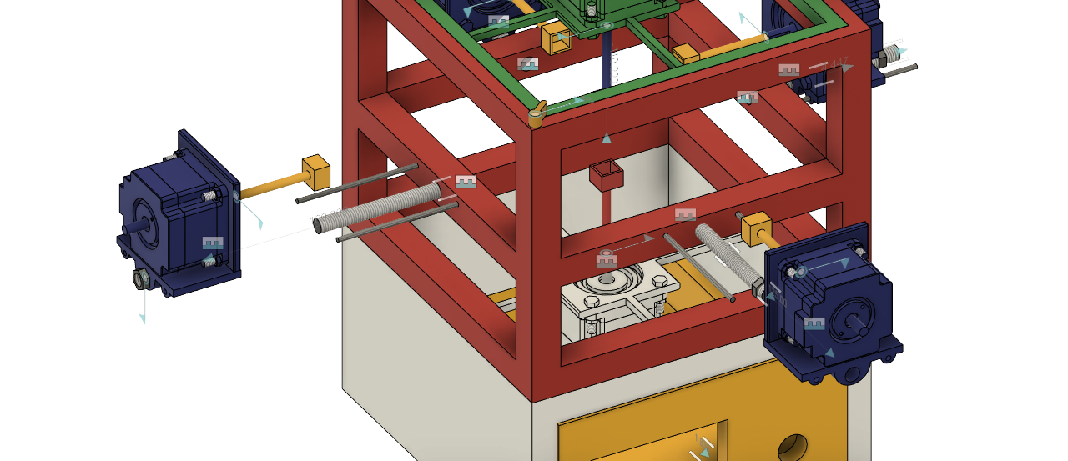

Slide 36
Prototype 3:
The structure is broken down into six major pieces:
A base that holds bottom-most motor, its driver and Arduino. All the wires from all six motors and power supply originate from here. All side mounts can slide into the sides of the base.
Four side mounts that hold a motor and its corresponding motor driver. The motor is still attached to a holder that can slide, same as in second design. The back side of the mount is perforated in order let the heat from the driver escape.
The upper frame has eight legs that fit into the side mounts which in turn are attached to the base. This structure holds the entire body firmly and ensure there are no stability issues. The frame also supports the top-most motor and its driver at its top.

Slide 37
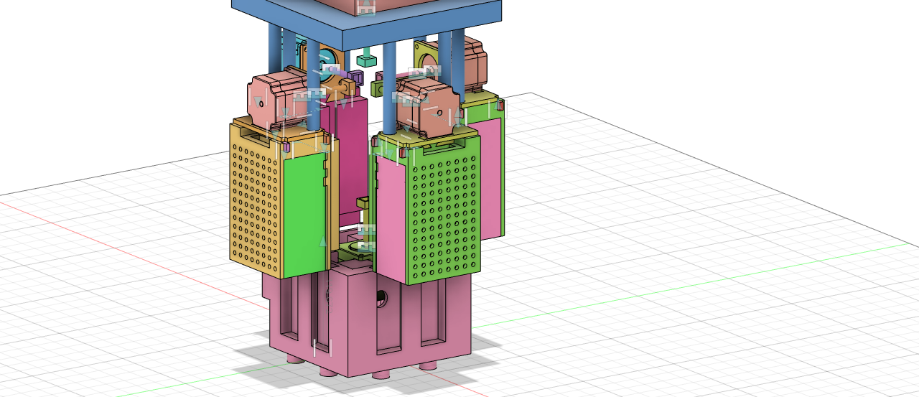
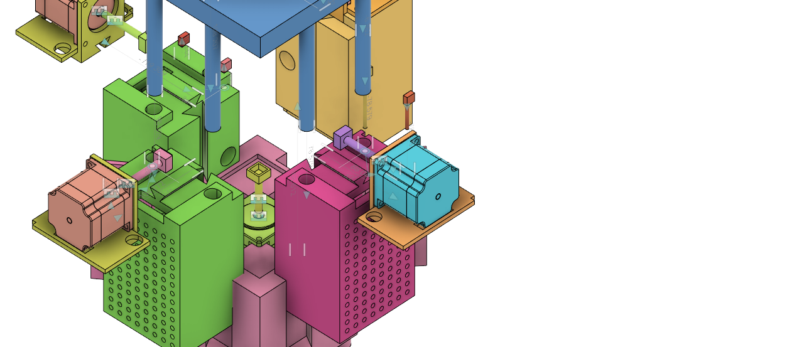

Slide 38
GENERAL FLOW OF WORKING OF ROBOT
ISL Cameras are used to detect the colors on different faces and Ultimaker CURA for 3D printing
Cube is placed inside the robot
Desired algorithms are used to generate step for solving the cube on a laptop
Arduino sends commands to stepper motors and the cube is solved
Instructions are sent to the Arduino for execution

Slide 39
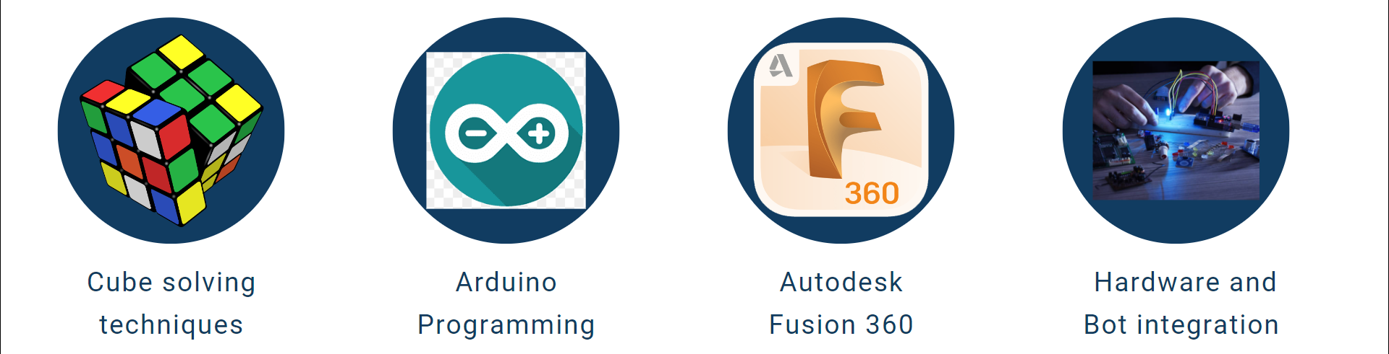
LEARNING OUTCOMES

Slide 40
OVERALL SUMMARY
Total number of offline meets: 6
Total number of online meets: 8
Tools and software used: Autodesk Fusion 360, basic knowledge of Arduino.
Resources used : (22) - 3X3 Rubik's Cube issued by SpeedCubing Club.
Venues: Robotics Club room, FB-471
Total number of mentees: 20

Slide 41

THANK YOU

